Slide 1
IMS project
By Haaris Moghal

Slide 2
Introduction My approach to the specification
Project objective:
To create a functional application
Focused on the MVP (Minimum Viable Product)
Project breakdown:
From the key deliverables which were given to me I was able to split them into user stories for my Kanban board.
Created SQL Schema
Implemented CRUD functionality
Used the code given and built on top/further.
Testing and built package.

Slide 3
Consultant journey
Version Control System: Git – Project management. Pushing and Reverting.
Source Code Management: GitHub. See the progress of the project coming together.
Database management system – MySQL
Backend programming language – Java and SQL
Testing – Junit and Mockito.
Build tools – Maven. Using dependencies and building application.
Project Management platform – Jira/Kanban board

Slide 4
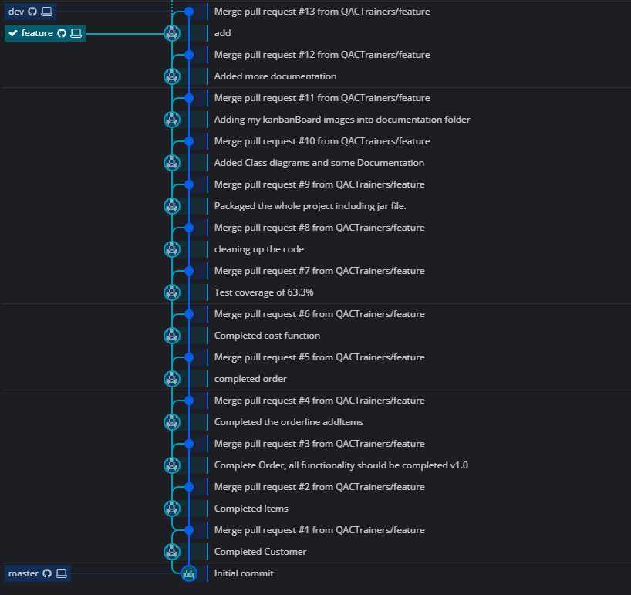
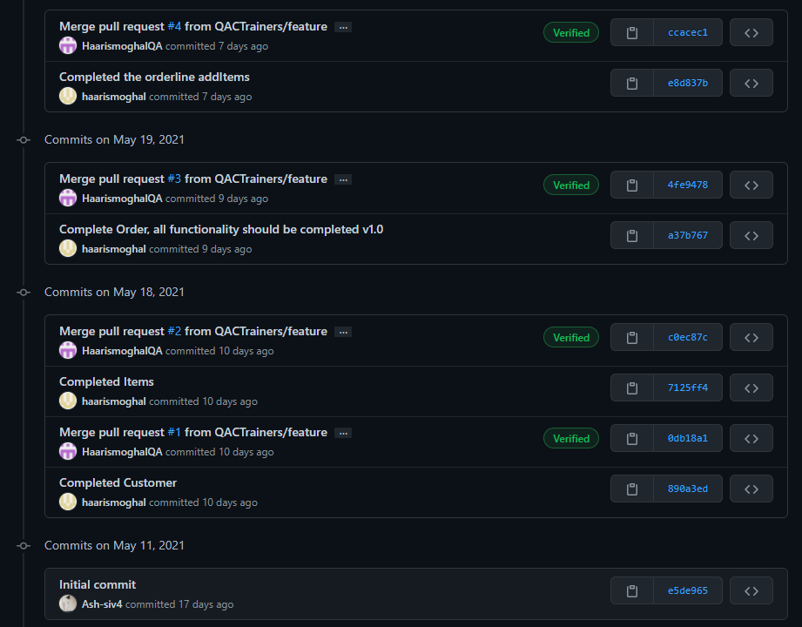
Continuous Integration
Git for version control
Used a Feature-branch model. (GitKraken)
Regular commits to ensure project safety.
Used Jira tags on most commits.

Slide 5
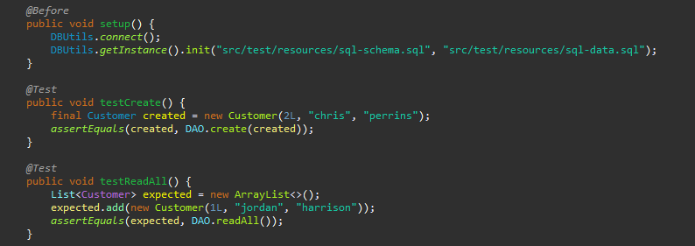
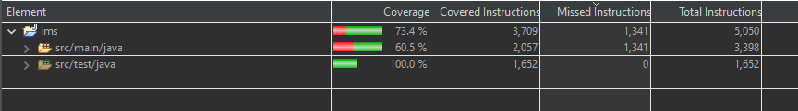
Testing
Managed to get 60.5% test coverage on src/main/java folder
Junit was used to test individual methods in each of the classes which were used. (Domain, DAO and Controller)
Mockito was used to mock objects so that I can use to test the methods.

Slide 6
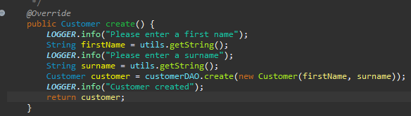
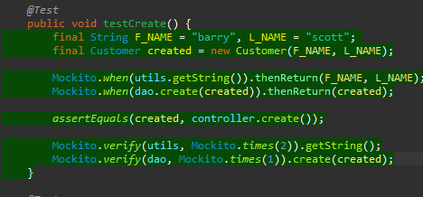
Testing- Mockito
Mockito was used along with Junit which allows you to create and configure mock objects
Mockito was used to mock objects so that I can use to test the methods.

Slide 7
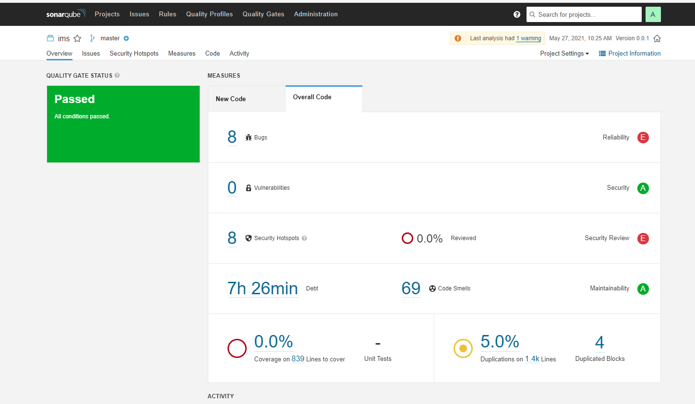
Testing – sonarqube
Sonarqube (Was done last – not fully working)
Refactored my code based on code smells feature.

Slide 8
Demonstration
User story 1: User is able to ADD a customer in the system SO THAT the customer can make an order.
User story 2: User is able to ADD an Item in the system SO THAT the customer can choose what Item they wish to order.
User story 3: User is able to CREATE an Order in the system SO THAT the customer can purchase some Items.
User story 3: User is able to get the Total Cost of an Order.

Slide 9
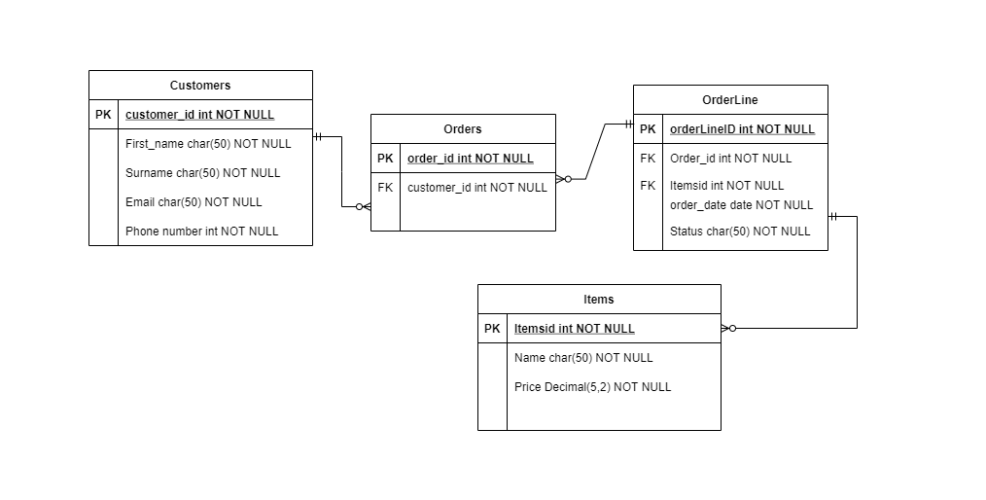
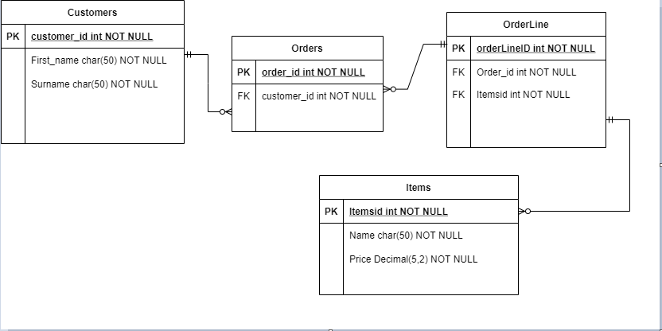
ERD Before and After
Before
After

Slide 10
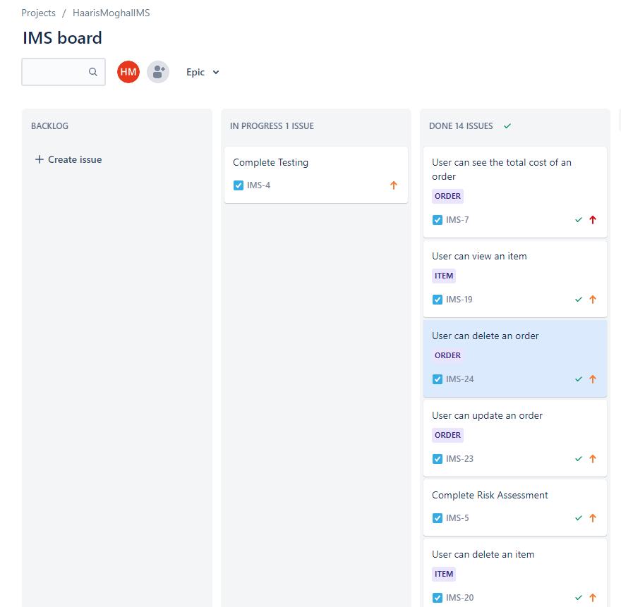
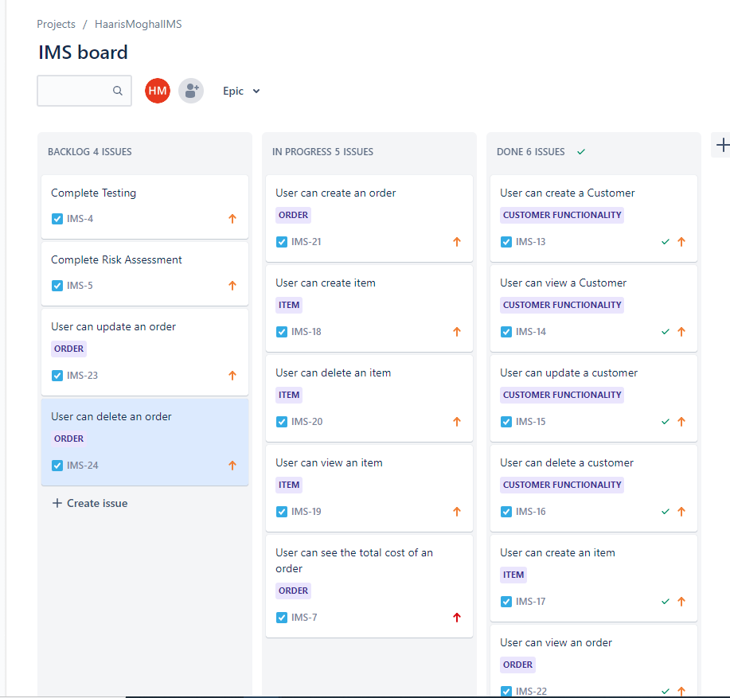
Jira
Week 1
Week 3

Slide 11
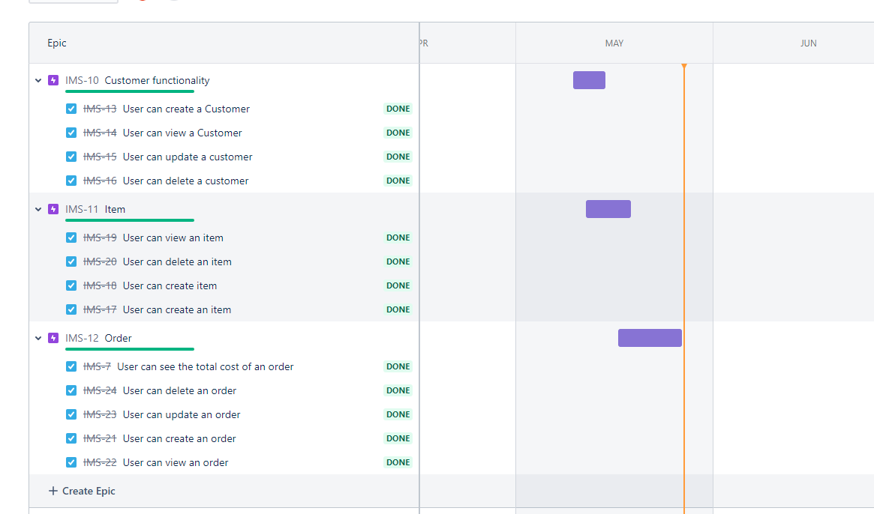
Jira roadmap

Slide 12
Sprint review
I managed to complete the main functionality of my code:
CRUD functionality for customer
CRUD functionality for item
CRUD functionality for order
Able to calculate cost for orders.
Testing.
What got left behind:
Was not able to get test coverage of 80%
New to testing

Slide 13
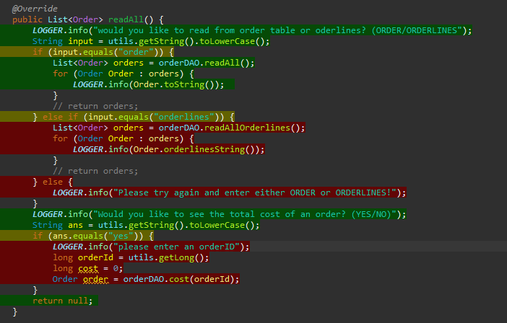
Sprint retrospective
What went well?
I was able to meet all user requirements
Version control
Improvements?
Higher test coverage
Refactor reading from orderliness – didn’t need it.
Time management (Not enough time on Testing (Learning and implementing)).

Slide 14
Conclusion
Creating this application has improved my knowledge:
Back-end programming : Java and MySQL
Testing : Junit, Mockito and Sonarqube
Overall the aims project have been met:
Crud functionality
Cost functionality
Using a database
Improvements?
More realistic with setting time frames of each sprints

Slide 15
Thank you for listening! Any questions?

